Slide 1


Virtual Computer Mouse using mmWave Radar (TI):
Oscar Chavez Araiza
ECEN 403 DEMO

Slide 2
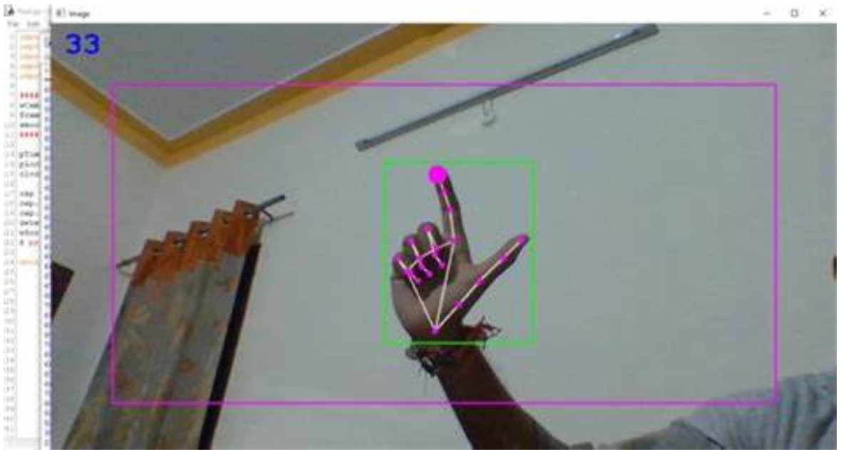
Subsystem Description:
The Gesture Recognition subsystem is responsible for using ML to detect hand gestures using TI’s radars.
I trained a CNN model to detect gestures in a 40 frame interval ~ 1.4s
These gestures will then be translated into mouse actions; left or right click by the input mapping subsystem.

Slide 3
Subsystem Description Pt.2
The ML model works by using TI’s parsed feature data extracted from the radar.
40 frames of data are fed as input into the model and the model will interpret the data as one of 3 gestures (Shine, Push, or NO_Gesture)
Training data was obtained using a python script that captured 40 frames into numbered files.

Slide 4
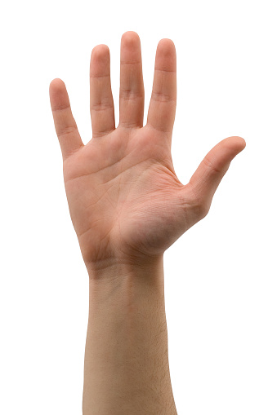
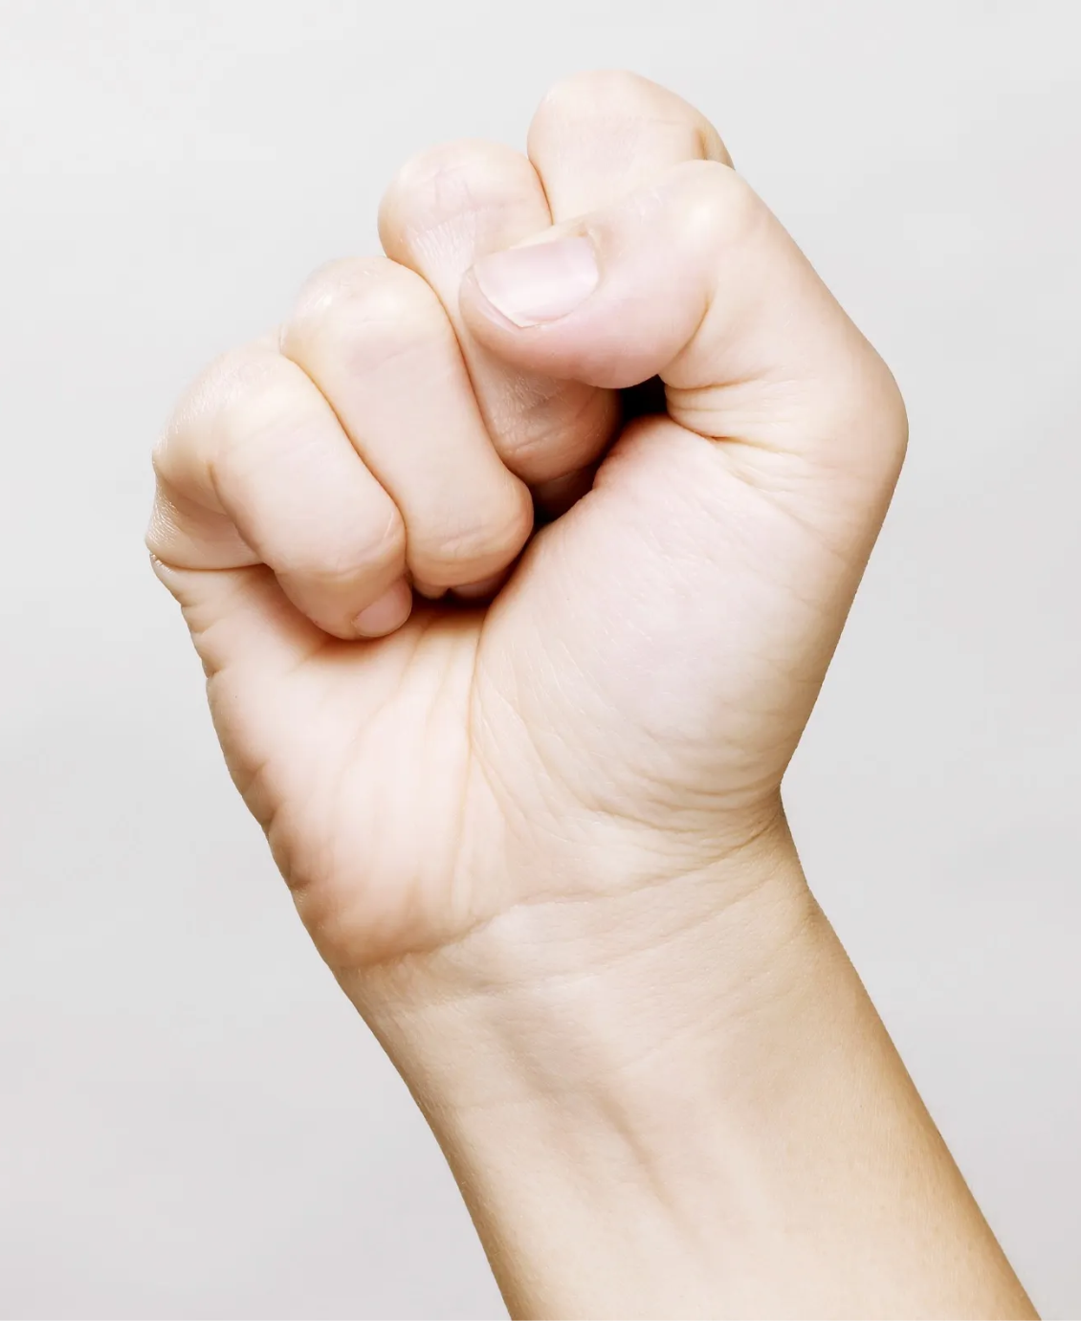
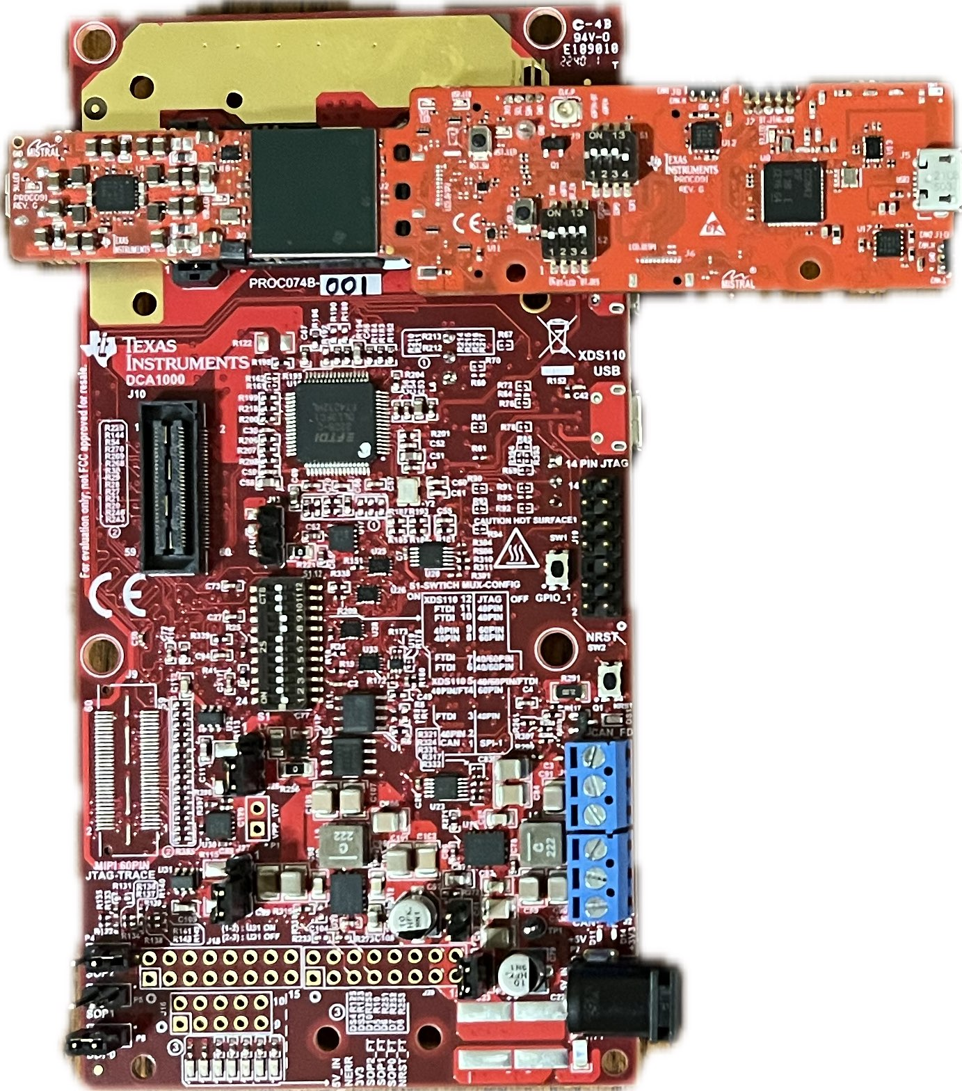
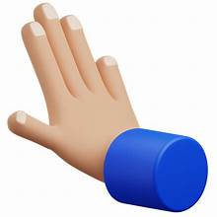

Gestures
Gesture [1] (L-Clk)
Shine Gesture
Gesture [2] (R-Clk)
Push Gesture

Slide 5
Gesture Recognition Work so Far
Some stats
Raw Accuracy | ~96.12%
Experimental Accuracy | ~94%
Max Detection Distance | ~1½ ft
Area of Detection at 1ft | ~1½ ft x 2 ft
Experimental Data
NO_GESTURE PUSH SHINE
NO_GESTURE
99% | 4% | 9.5%
0.5% | 95% | .5%
0.5% | 1% | 90%
PUSH
SHINE
Horizontal: Expected
Vertical: Actual //Each column adds up to 1

Slide 6
Area of Detection at ~1ft
~2ft
~1.5ft
*The radar has less range under the sensors than above them

Slide 7
Validation
Section | Task | Specification | Result | Owner
3.2.1.5 | Hand Gesture Recognition | ML model can recognize the users hand gestures | Passed | Oscar
3.2.1.5 | Hand Size | Radar will recognize gestures regardless of hand size. | Passed, but only use limited data | Oscar
3.2.1.5 | Gesture Recognition Accuracy | ML model can correctly identify and categorize hand gestures at least 90% of the time. | Passed | Oscar
In the FSR I had another task that required the model to only track in one orientation, but after some consideration we decided to remove that functional requirement.

